Slide 1
BUSINESS 100
Chapter 14
Notes:
NAME TAGS NEED YOUR NAME ON BOTH SIDES
BRINGING YOUR NAME TAGS EACH CLASS WILL BE CONSIDERED IN THE PARTICIPATION MARKS – SINCE BUSINESS IS ALL ABOUT BUILDING RELATIONSHIPS.

Slide 2
It is almost impossible
to understand business operations without being
able to understand and
analyze accounting reports
and financial statements
Source - Understanding Canadian Business – 8th Edition

Slide 3
Understanding Key
Financial Statements
Balance Sheet
3 main types of accounts:
Assets: items of value owned by a firm.
Liabilities: what a business owes to others (debt)
Equity: profits accumulated over the life of the business plus value of the shares of the company
Assets – Liabilities = Equity

Slide 4
Understanding Key
Financial Statements
Definitions:
Liquidity: how fast an asset can be converted into cash
  How quickly can you sell it?
Current – with a year
Long term – longer than a 1 year
Accounts receivable – customers who buy a product and do not pay for it immediately
Accounts payable: what the company owes to suppliers who have already sent them the product
  * company will pay before one year

Slide 5
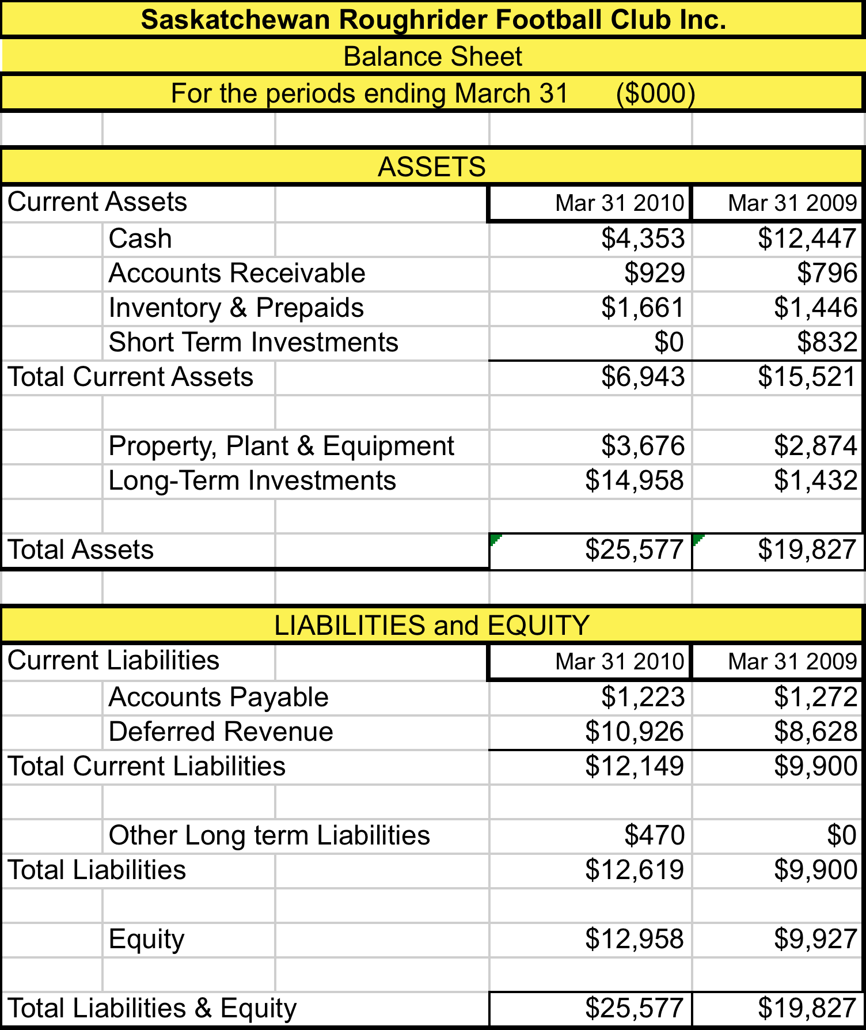

Slide 6
Analyzing Financial Statements Ratio Analysis
Ratio analysis: the assessment of a firm’s financial condition and performance
  Current ratio = current assets
  current liabilities
    Does the company have enough current assets to pay their current liabilities?
  Debt to equity ratio = total liabilities
  equity
    How much money do they owe others vs how much they have invested

Slide 8
Analyzing Financial Statements
Ratio Analysis
  Is there enough money for the Riders to meet their current obligations?
  Current ratio = current assets/current liabilities
    Current assets = $6,943 and $15,521
    Current Liabilities = $12,140 and $9,900
    Current ratio – 2010 - .57 (6943/12140)
    Current ratio - 2009 – 1.57 (15521/9900)
    Why the big change??

Slide 9
Analyzing Financial Statements Ratio Analysis
  Debt to equity ratio = total liabilities
  equity
  Total Liabilities - $12,619 and $9,900
  Equity - $12,958 and $9,927
  Ratio – 2010 - .97 (12619/12958)
  Ration – 2009 – 1.0 (9900/9927)
  Consistent from year to year
  Balance of debt and own money

Slide 10
Understanding Key
Financial Statements
INCOME STATEMENTS
2 main types of accounts :
Revenues: money generated by the company through sales.
Expenses: costs incurred by the company to operate the business
Revenues – Expenses = Profit

Slide 11
Understanding Key
Financial Statements
INCOME STATEMENT
Gross Profit : Revenues minus the cost of items sold
Not all business expense are included in gross profit
Profit = Net income or net loss
Revenues minus all expenses including income taxes
Revenues – Expenses = Income

Slide 12
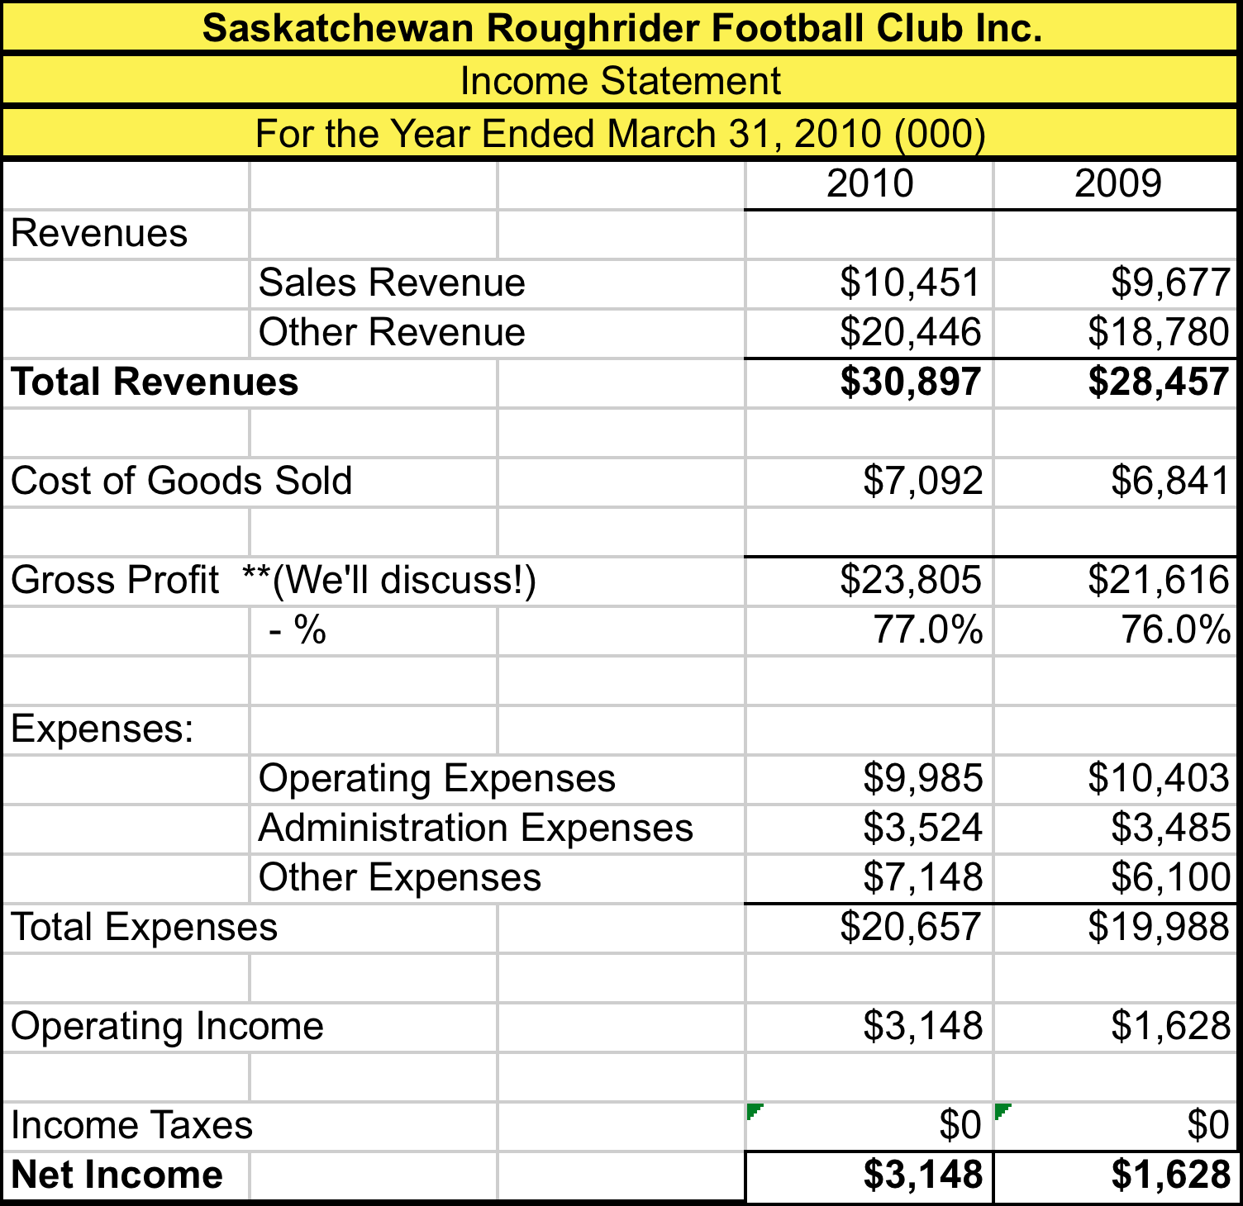

Slide 13
Understanding Key
Financial Statements
Financial statement: summary of all of the transactions that have occurred over a particular period.
Balance sheet: the financial statement that reports a firm’s financial condition at a specific time
  As at March 31, xx
Income statement: financial statement that shows a firm’s profit after covering all costs, expenses, and taxes over a period of time.
  For the year ended March 31, xx
Cash flow statement: reports cash receipts and disbursements to the firm during a period of time

Slide 14
Final Exam Expectations
Role – Bank Manager
Required:
Prepare a formal income statement
Analyze the balance sheet – consider date and type of business. Risk assessment
Qualitative – outline what you will find/ found and WHY it is relevant to a bank loan application
Quantitative – calculate current and debt to equity ratios
RECOMMEND whether you would grant the bank loan and WHY

Slide 15
Scenario 1
University of Regina Bookstore on August 31
Inventory – what do you expect to see?
Accounts receivable – what do you expect to see?
Accounts payable – what do you expect to see?

Slide 16
Scenario 2
University of Regina Bookstore on May 31
Inventory – what do you expect to see?
Accounts receivable – what do you expect to see?
Accounts payable – what do you expect to see?

Slide 17
Scenario 3
University of Regina Bakery on May 31
Open Monday to Friday
Inventory – what do you expect to see?
Accounts receivable – what do you expect to see?
Accounts payable – what do you expect to see?

Slide 18
Scenario 4
It is December 1,xx. You are a bank manager. The owner of Alpine Ski Shop in Regina is meeting with you today. She will be asking you for a bank loan. She is bringing her November 30, xx financial statements
When you prepare for the meeting, you consider:
Inventory – what do you expect to see?
Accounts receivable – what do you expect to see?
Accounts payable – what do you expect to see?
Collateral – what is available?
How much money does she owe to other people?
How much money has she invested?

Slide 19
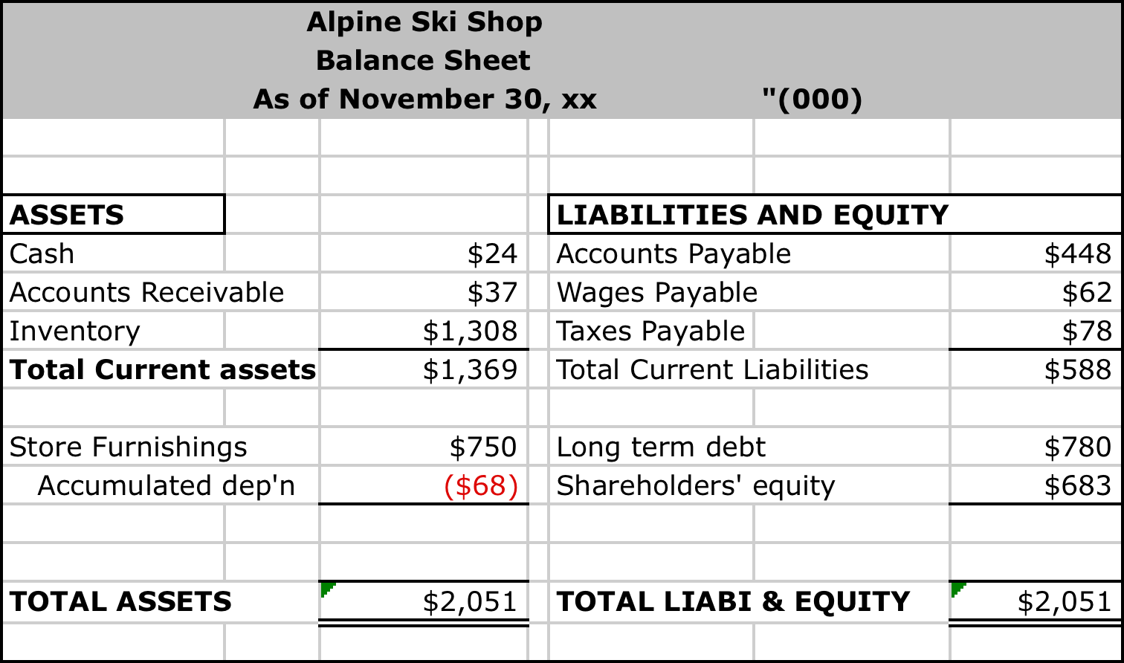

Slide 20
  Current ratio = current assets
  current liabilities
    Does the company have enough current assets to pay their current liabilities?
    $1369/$588= 2.3
  Debt to equity ratio = total liabilities
  equity
    How much money do they owe others vs how much they have invested
    ($588+ $780)/$683 = 2.0

Slide 21
Scenario 5
It is July 1, xx. You are a bank manager. The owner of Saskatchewan Agriculture Seeding Equipment is meeting with you today. He will be asking you for a bank loan. He is bringing his June 30, xx financial statements
When you prepare for the meeting, you consider:
Inventory – what do you expect to see?
Accounts receivable – what do you expect to see?
Accounts payable – what do you expect to see?
Collateral – what is available?
How much money does he owe to other people?
How much money has he invested?

Slide 22
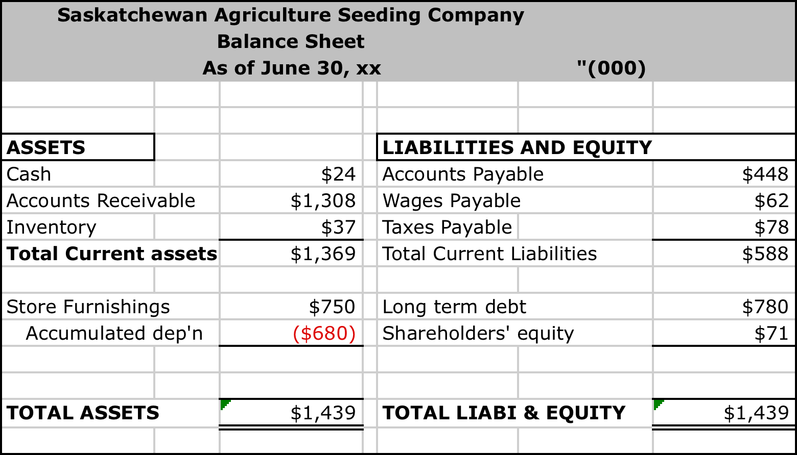

Slide 23
  Current ratio = current assets
  current liabilities
    Does the company have enough current assets to pay their current liabilities?
    $1369/$588= 2.3
  Debt to equity ratio = total liabilities
  equity
    How much money do they owe others vs how much they have invested
    ($588+$780)/$71 = 19.27

Slide 24
Scenario 6
It is October 1, xx. You are a bank manager and the owners of New Start Up Company of Regina are meeting with you today. They will be asking you for a bank loan. They are bringing their September 30, xx financial statements
When you prepare for the meeting, you consider:
Inventory – what do you expect to see?
Accounts receivable – what do you expect to see?
Accounts payable – what do you expect to see?
Collateral – what is available?
How much money do they owe to other people?
How much money do they have invested?

Slide 25
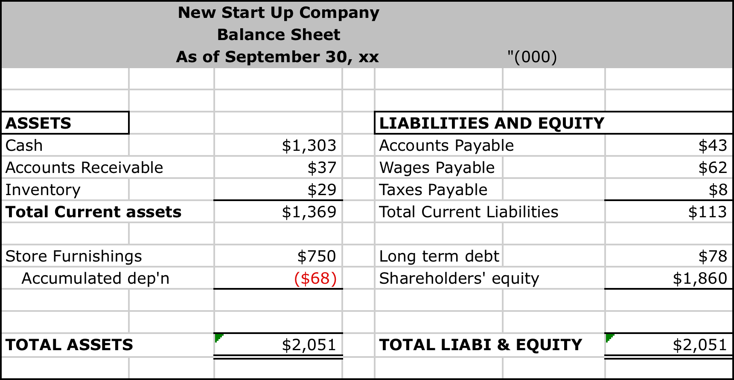

Slide 26
  Current ratio = current assets
  current liabilities
    Does the company have enough current assets to pay their current liabilities?
    $1369/$113 = 10.29
  Debt to equity ratio = total liabilities
  equity
    How much money do they owe others vs how much they have invested
    ($113+$78)/$1860 = .10

Slide 27
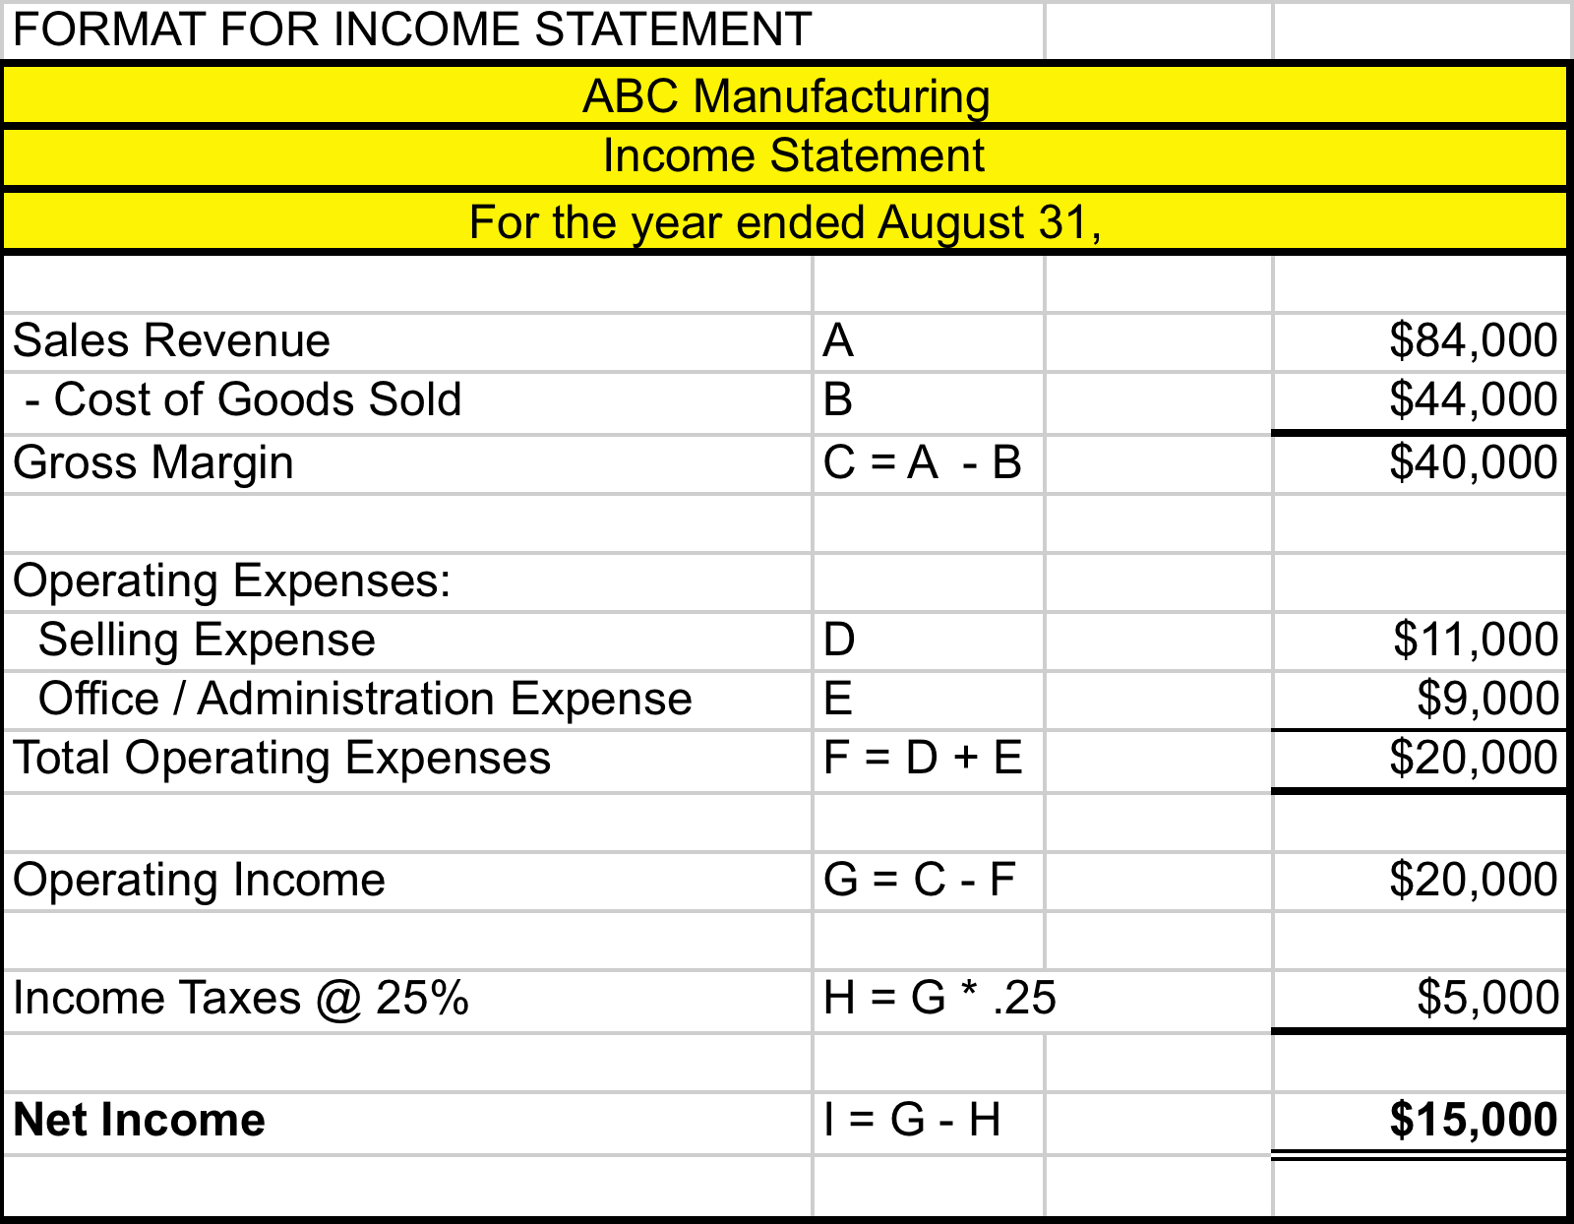

Slide 28
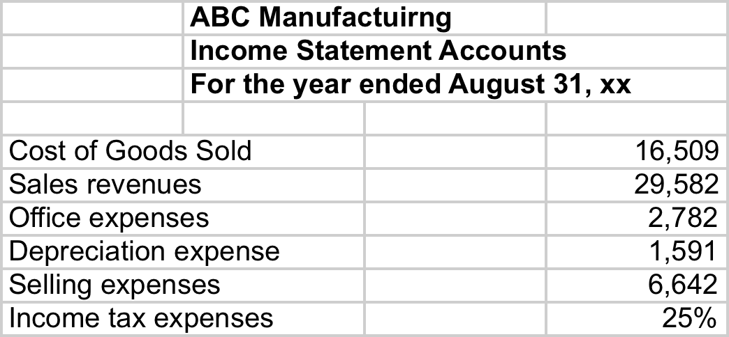

Slide 30
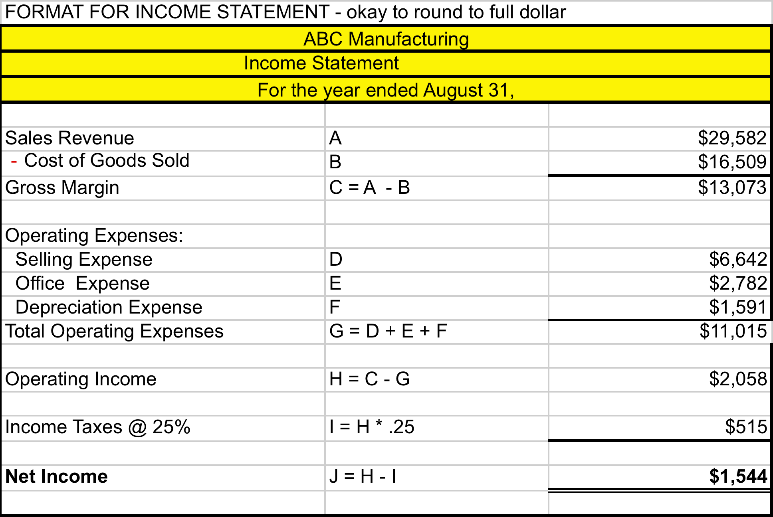

Slide 31
Final Exam Expectations
Role – Bank Manager
Required:
Prepare a formal income statement
Analyze the balance sheet – consider date and type of business – risk assessment
Qualitative – outline what you will find/ found and WHY it is relevant to a bank loan application
Quantitative – calculate current and debt to equity ratios
RECOMMEND whether you would grant the bank loan and WHY

